Slide 1
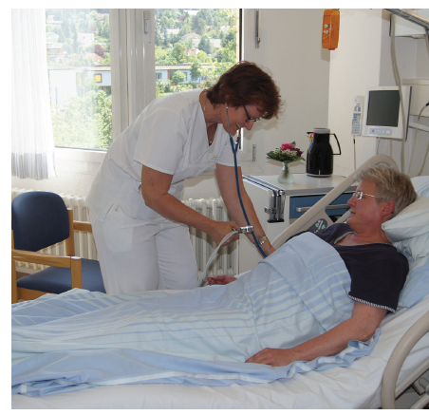

The Stroke Nurse Project
A community-based approach to improving the post-acute care of stroke patients.
Thomas Staudacher, Pia Bader, Jürgen Kunz,
Dietmar Bengel and Hans Joachim von Büdingen
Ravensburg, Germany

Slide 2
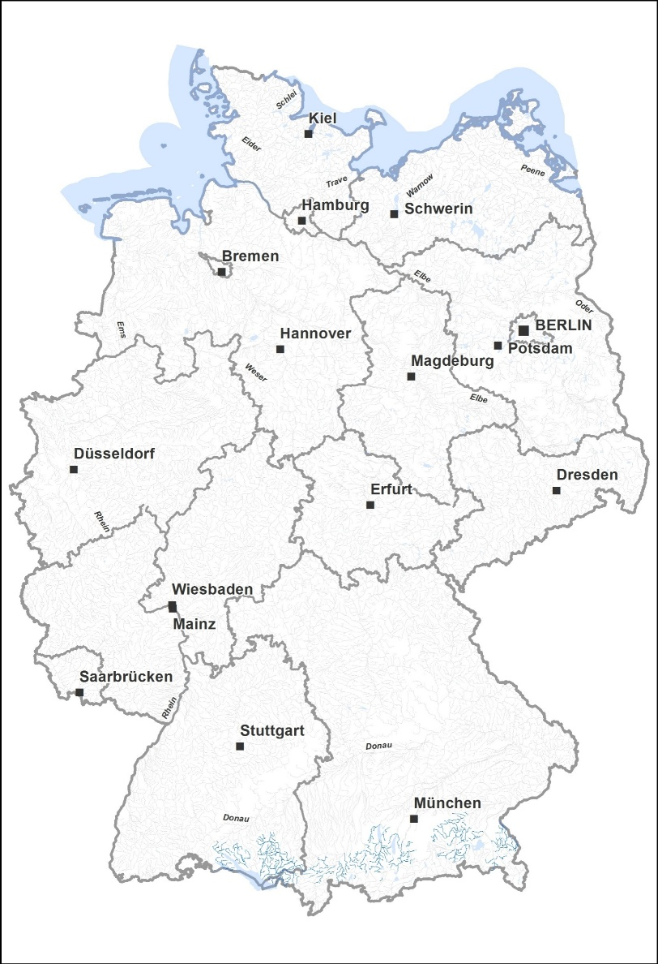
Where do we come from?
Germany
France
Ravensburg
Switzerland

Slide 3
Stroke Unit Ravensburg
14 intermediate care beds
1100 stroke patients per year
~ 25% of ischemic stroke patients are treated with iv-thrombolysis
~ 10% receive intravascular treatment (thrombectomy, i.a.-thrombolysis)

Slide 10
The Stroke Nurse Project
The Aims
To evaluate stroke recurrence, mortality and psychosocial parameters in a single-center, uncontrolled, observational, prospective study.
To assist patients and their relatives / caregivers in coping with psychosocial challenges.
To ascertain patients’ adherence to secondary prevention guidelines.
To encourage professional medical care by neurologists.

Slide 11
The Stroke Nurse Project
The Mission
Recruitment of patients prior to discharge from the stroke unit.
Defining aims for secondary prevention.
Checking if these aims are fulfilled.
Organizing post-hospital care by a Neurologist.
Phone calls after discharge to recognize problems and needs for help.
Continued motivation of patients and caregivers
Two home visits at 3 and 6 months.
Final interview by phone after 12 months.

Slide 12

The Stroke Nurse Project
Inclusion criteria
Treatment in local SU due to stroke or TIA.
High risk-profile (even in TIA patients).
Living at a distance to Ravensburg of less than 25 miles.

Slide 13
The Stroke Nurse Project
Patient Characteristics
Observation period:
Patients enrolled:
Mean age:
Qualifying event:
April 2012 – January 2015
290 (41% female)
67 years (24 – 95)
Ischemic stroke (84%)
TIA (8%)
Hemorrhagic stroke (8%)

Slide 14
The Stroke Nurse Project
Patient Characteristics

Slide 15
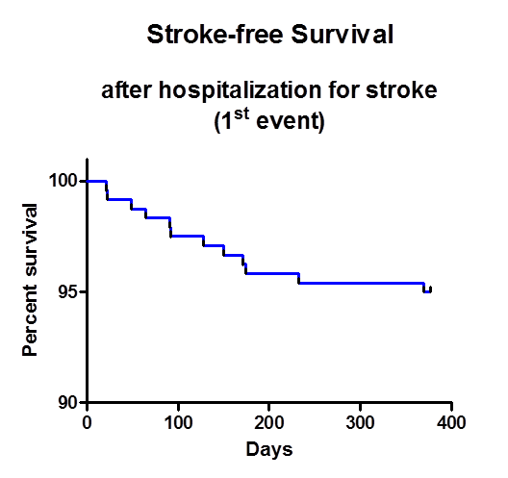
The Stroke Nurse Project
Results
Stroke-free Survival
After hospitalization for Stroke
(1st event)
Percent survival

Slide 16
The Stroke Nurse Project
Results
Overall Survival
After hospitalization for Stroke
(1st event)
Percent survival

